Slide 1
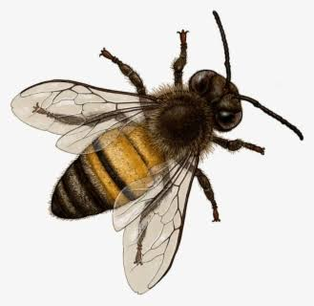

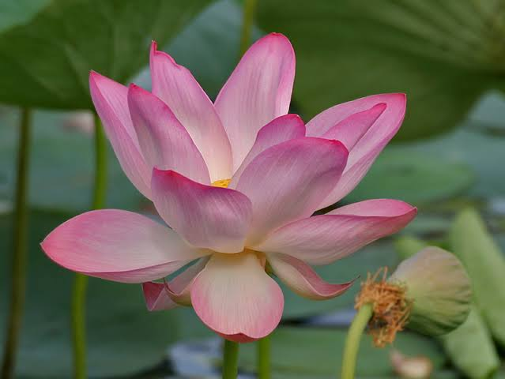
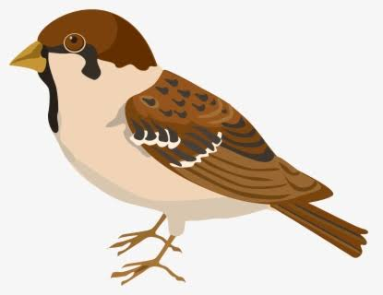
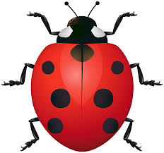
Butterfly, Butterfly, What Do You See?
Garden theme - by Kruppavathy K

Slide 2

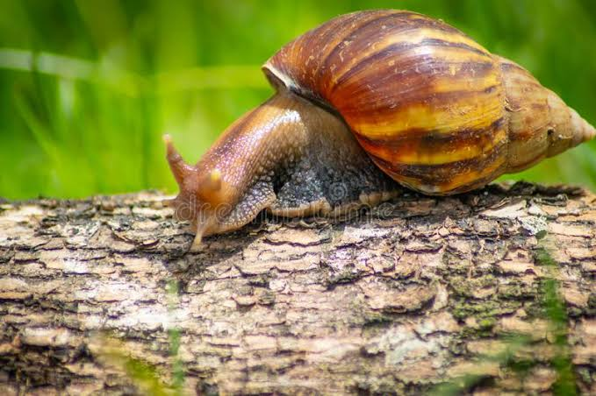
Butterfly butterfly what do you see?
I see a brown snail crawling on a log.

Slide 3
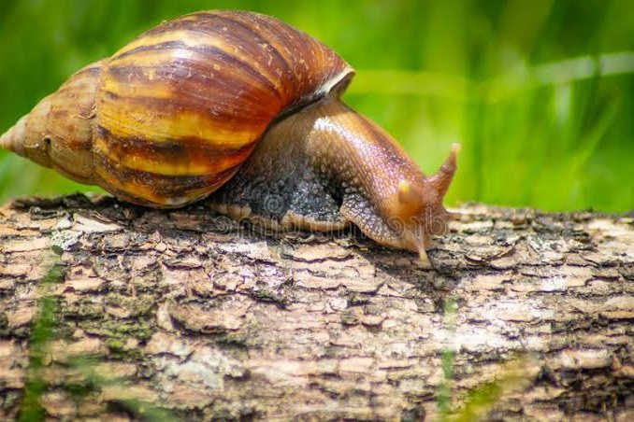
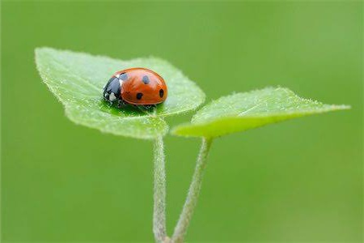
Brown snail brown snail what do you see?
I see a red ladybug creeping on a leaf.

Slide 4
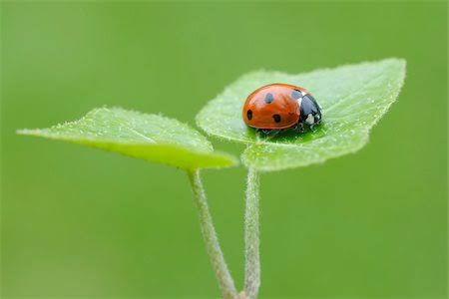
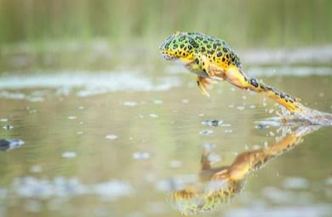
Red ladybug, red ladybug what do you see?
I see a green frog jumping in a pond

Slide 5

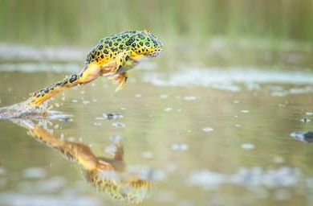
Green frog, green frog what do you see?
I see a pink lotus looking at the sun

Slide 6

Lotus, lotus what do you see?
I see a yellow sun shining at me.

Slide 7

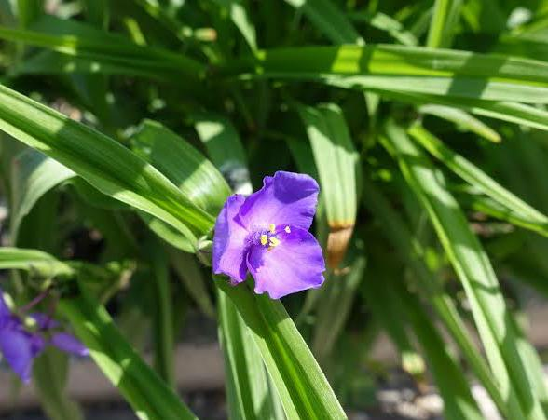
Yellow sun, yellow sun what do you see?
I see a purple flower blooming on a plant.

Slide 8
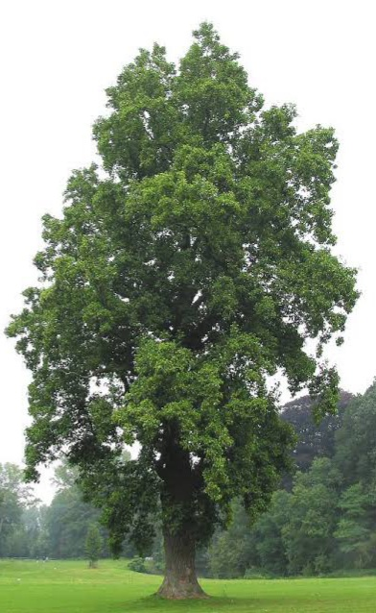
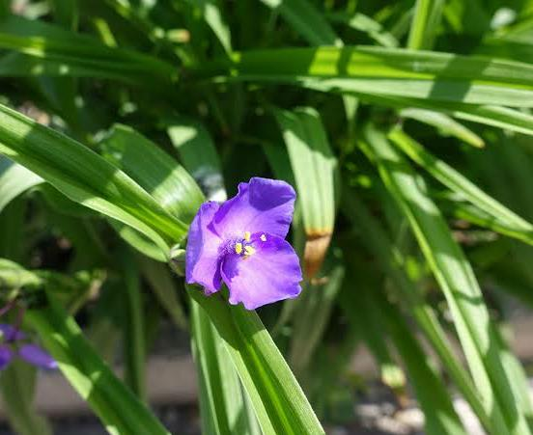
Purple flower, purple flower what do you see?
I see a tall tree standing straight in the garden.

Slide 9
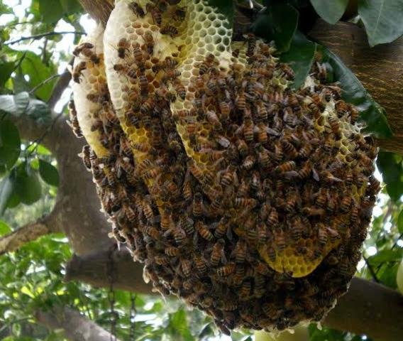
Tall tree, tall tree what do you see?
I see the honey bees buzzing in the hive.

Slide 10
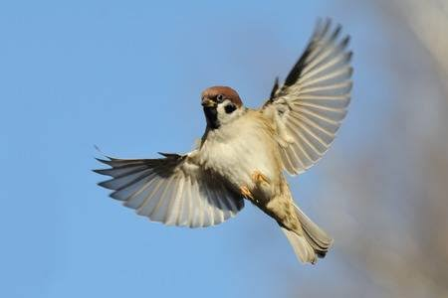
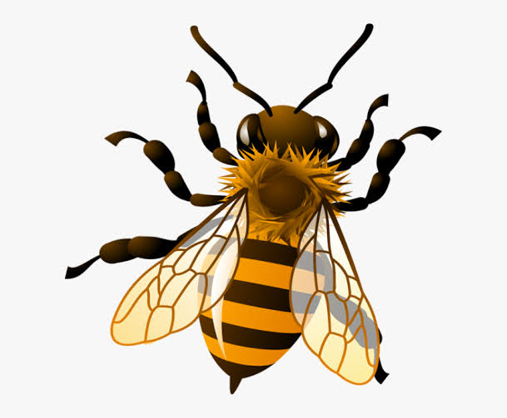
Honey bee honey bee what do you see?
I see a little bird flying high in the sky.

Slide 11

Little bird little bird what do you see?
I see the little children smiling at me

